Slide 1
Module – 3
NON-LINEAR APPLICATIONS OF OPAMP

Slide 2
NON-LINEAR APPLICATIONS OF OPAMP
Learning Outcomes:
At the end of this module, students will be able to :
Discuss different types of OPAMP based Comparators.
2. Discuss OPAMP based square wave generator circuit.

Slide 3
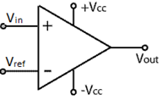

NON-LINEAR APPLICATIONS OF OPAMP
Voltage Comparator:
The output voltage of a comparator is given by
Notes:
The op-amp in open loop configuration is used as a voltage comparator as shown in Figure 1. It compares two voltages and outputs one of two states depending on which is greater.

Slide 4
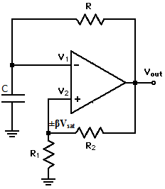
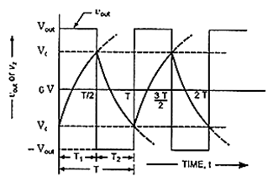
SQUARE WAVE GENERATOR
Fig 1. Square wave generator
Fig 2. Output waveforms
Ref: Non-linear appln.docx

Slide 5


SQUARE WAVE GENERATOR
The time period of the square wave generated is
T=
Where
Peak to peak amplitude of the square wave generated is

Slide 6
Self Test:
The phase difference between input & output signal of an op-amp inverter is ____ degree.
The gain of op-amp based non- inverting amplifier with input resistance R1 and feedback R_{f} is _____.
How does a practical op-amp differ from an ideal op-amp?
What is the significance of Slew rate?
Distinguish between differential gain and common mode gain of an op-amp.

Slide 7
Square Wave Generator using 741 Op-Amp Working
Initially, the voltage across the ‘C1’capacitor will be zero and the o/p of the op-amp will be high. As a result, the ‘C1’capacitor starts charging to +Ve voltage through ‘R1’ potentiometer. When the ‘C1’capacitor is charged with a level so that the voltage at the inverting terminal of the op-amp is above the voltage at the non-inverting terminal. The output of the op-amp swings to negative.
The capacitor rapidly discharges through R1 and then starts charging to negative voltage. When the ‘C1’ is charged to a negative voltage so that the voltage at the inverting i/p more negative than that of the non-inverting pin. The o/p of the op-amp swings back to positive voltage. Now the capacitor rapidly discharges the negative voltage through ‘R1’ and starts charging to +Ve voltage. This cycle is recurrent infinite and the outcome will a nonstop square wave swinging between +Vcc &-Vcc at the output

Slide 8
Summary
In this module we have learnt:
1. The working of OPAMP comparator
2. Analysis of OPAMP based square wave generator.

